Slide 1
Lecture 5 Introducing Statistics
Beckerman et al. p. 93-108

Slide 3
Statistics
Never start an analysis with statistical tests. Always start an analysis with a figure.
Once you’ve made a figure, you embark on translating the hypothesis you are testing into a statistical model and this model into R language.
Assess assumptions of statistical model, then interpret results (data should meet assumptions before any interpretation is valid); test statistic and associated P-value
The final step is to integrate the modelling results into your original figure—a process some of you may know as adding predicted or fitted lines (or points) to your graph.

Slide 4
Workflow:
plot your data,
(2) build your model,
(3) check your assumptions,
(4) interpret your model, and
(5) replot the data and the model.

Slide 5
OR
Chi-Square Test
x-axis ≥ 2 categories (group A, B, etc.)
y-axis ≥ 2 categories (dead or alive)
Count Alive
Count Alive
Count Dead
Count
Count Dead
No Drug
Drug A
Drug B
No Drug
Drug A
Drug B
Because they are grouped counts (one value for each unique condition,
there is no measure of variation (error bars) to display.
Each group has only one count.

Slide 6
χ² Contingency Analysis
The χ² contingency table analysis is an analysis of count data. It is essentially a test of association among two or more categorical variables.
When you have a set of observations, and for each of these you can classify them by more than one categorical variable, for example, sex, male/female, and life stage, juvenile/mature).

Slide 7
Ladybirds Example
We have collected data on the frequency of black and red ladybirds (Adalia bipunctata) in industrial and rural habitats. (ladybugs)
Morph = 2 categorical levels (black and red)
Habitat = 2 categorical levels (industrial and rural)
Test of ‘Industrial Melanism’ Hypothesis; different frequency of dark morph in industrial areas due to camouflage advantage.
http://www.r4all.org/the-book/datasets
The data file is: ladybirds_morph_colour.csv.

Slide 8
Ladybirds Example
By performing a χ² contingency table analysis, we are testing the null hypothesis that there is no association between ladybird colors and their habitat.
The alternative hypothesis is that there is an association.
Direction of association is not specified (but should be obvious from graph).
NOTE: These are statistical hypotheses, not logical/research hypothesis. We know this because there is no ‘explanation’ being proposed for the obs.
Notes:
Note that these are statistical hypotheses.

Slide 9
# import the data
lady <- read.csv("ladybirds_morph_colour.csv")
# Check it out
glimpse(lady)
Rows: 20
Columns: 4
$ Habitat <chr> "Rural", "Rural", "Rural", "Rural", "Rural", "Rural", "Rural", "Rural", "Rural",…
$ Site <chr> "R1", "R2", "R3", "R4", "R5", "R1", "R2", "R3", "R4", "R5", "U1", "U2", "U3", "U…
$ morph_colour <chr> "black", "black", "black", "black", "black", "red", "red", "red", "red", "red", …
$ number <int> 10, 3, 4, 7, 6, 15, 18, 9, 12, 16, 32, 25, 25, 17, 16, 17, 23, 21, 9, 15

Slide 10
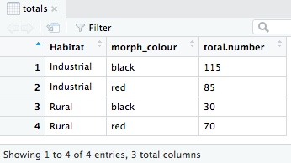
Organize Data for Plotting and Analysis
To test if the frequencies of the two color morphs of ladybirds differ between the two habitat types, the first thing we need to calculate are these totals
totals <- lady %>%
group_by(Habitat, morph_colour) %>%
summarise(total.number = sum(number))
Notes:
Recall that these are the default plotting colors in R (tidyverse)
colour = morph_colour with a bar alters the outline of the bar, not the fill colour.

Slide 11
Plotting and Analysis
ggplot(totals, aes(x = Habitat, y = total.number,
fill = morph_colour)) +
geom_bar(stat = 'identity', position = 'dodge')
Notes:
Recall that these are the default plotting colors in R (tidyverse)
colour = morph_colour with a bar alters the outline of the bar, not the fill colour.

Slide 12
Bar Chart Aesthetics
The ggplot() syntax has some new
things in which to pay attention.
First, we see a new part of the aesthetic,
fill = morph_color This is used when the ‘geometry’ is something like a bar and can be filled. Don’t confuse with:
color = morph_color with a bar alters the outline of the bar, not the fill color.

Slide 13
Bar Chart Aesthetics
Second, geom_bar() has some arguments that are not necessarily intuitive.
stat = ‘identity’ tells ggplot not to calculate anything from the data.
position = ‘dodge’ is a request to put the two bars in each Habitat group (e.g. black and red counts) next to each other.
If you don’t use the position = ‘dodge’
option you’ll end up with a stacked
barplot.

Slide 14
Make the Colors Less Sucky…..
We use scale_fill_manual; it takes an argument called values that is a set of colors to use:
ggplot(totals, aes(x = Habitat, y = total.number,
fill = morph_colour)) +
geom_bar(stat = 'identity', position = 'dodge') +
scale_fill_manual(values = c(black = "black", red = "red"))
Single and double quotes delimit
Character constants. They can be
used interchangeably in R, but double
quotes are preferred (and character
constants are printed using double quotes).
Notes:
Base R Help: https://stat.ethz.ch/R-manual/R-patched/library/base/html/Quotes.html
To avoid confusion for those who are accustomed to programming in the C family of languages (C, C++, Java), where there is a difference in the meaning of single quotes and double quotes. A C programmer reads 'a' as a single character and "a" as a character string consisting of the letter 'a' followed by a null character to terminate the string.
In R there is no character data type, there are only character strings. For consistency with other languages it helps if character strings are delimited by double quotes. The single quote version in R is for convenience.
(Since) On most keyboards you don't need to use the shift key to type a single quote but you do need the shift for a double quote.

Slide 15
Making the χ² Test
Do we think the null hypothesis—no association between color morphs and habitat, the same relative abundance of black and red morphs in each habitat—is true or not.
Use the function chisq.test(). But, to make this function do a two-way contingency test, we must give it a matrix of the total counts. Although they can look superficially similar, a matrix is different from a data frame.
We introduce one trick here that
transforms this data frame into the
matrix we need for the χ² test:
the function xtabs().
Two ways to do this based on
data we have (2 existing dataframes)

Slide 16
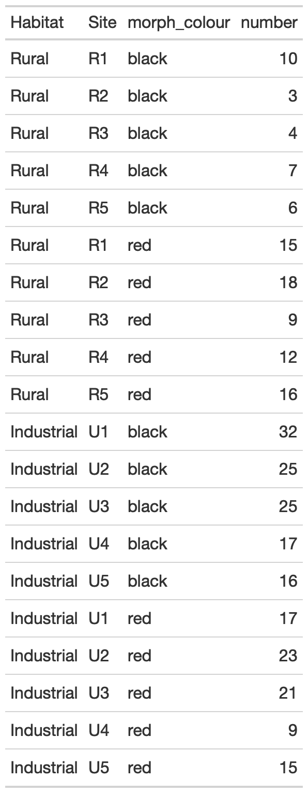
Summarize Raw Count Data – ‘lady’
lady.mat <- xtabs(number ~ Habitat + morph_colour,
data = lady)
#The formula reads, ‘Please cross-tabulate the
#number column of counts in the lady data
#frame by the Habitat and morph_colour
#variables.’
lady.mat
## morph_colour
## Habitat black red
## Industrial 115 85
## Rural 30 70

Slide 17
Reformat Summary Data Used for Barchart – ‘totals’
lady.mat2 <- xtabs(total.number ~ Habitat + morph_colour,
data = totals)
#The formula reads, ‘Please cross-tabulate the
#total.number column of counts in the totals data
#frame by the Habitat and morph_colour
#variables.’
lady.mat2
## morph_colour
## Habitat black red
## Industrial 115 85
## Rural 30 70
Either method will work the same.
I think the first method is more intuitive.

Slide 18
We know we have been successful when we have a simple matrix of all possible combinations of factors:
2 levels of Habitat * 2 levels of morph_color = 4 unique conditions
lady.mat
## morph_colour
## Habitat black red
## Industrial 115 85
## Rural 30 70
In this case (and in nearly all cases), formatting the data is much more work than doing the chi-square test.

Slide 19
chisq.test(lady.mat)
## Pearson's Chi-squared test with Yates' continuity
## correction
##
## data: lady.mat
## X-squared = 19.103, df = 1, p-value = 1.239e-05
What might we report in a manuscript?
“We tested the hypothesis that there is an association between color morphs of ladybirds and industrial and rural habitats. Ladybird color morphs are not equally distributed in the two habitats (χ² = 19.1, df = 1, p < 0.001), with black morphs being more frequent in industrial habitats and red morphs more frequent in rural habitats (Figure 5.1).”
Notes:
By the way, if you are wondering what that ‘Yates’ continuity correction’
is all about, it refers to a little adjustment of the χ2 test that makes it a bit
more reliable when the counts are small. For those of you who are familiar
with the mechanics of the χ2 test (row sums, column sums, observed and
expected values), you will be pleased to know that all of these are accessible
to you, simply by assigning the values returned by chisq.test() to a name
and then looking at these:

Slide 20
Two-sample t-test (Student’s t-test)
Student’s t-Test
x-axis = 2 categories (groups A and B)
y-axis is continuous measure (tumor size)
Tumor Size (mm)
Drug A
Drug B

Slide 21
Two-sample t-test (Student’s t-test)
The two-sample t-test is a comparison of the means of two groups of numeric values.
Appropriate for small sample sizes (<~30 samples)
Student’s t-test assumes that the data in each group are normally distributed and that their variances are equal.
Example: We are interested in whether there is a difference in the average ozone concentration between gardens in the east and the west (note, two levels of a categorical factor).
ozone <- read.csv("ozone.csv")
glimpse(ozone)
Observations: 20
Variables: 3
$ Ozone <dbl> 61.7, 64.0, 72.4, 56.8,....
$ Garden.location <fctr> West, West, West, West....
$ Garden.ID <fctr> G1, G2, G3, G4, G5, G6,….

Slide 22
As always in analyses, first plot the data
ggplot(ozone, aes(x = Ozone)) +
geom_histogram(binwidth = 10) +
facet_wrap(~ Garden.location, ncol = 1) +
theme_bw()
Based on the plots, we’ll assume normality
and equal variance assumptions are met (for now).
Second reason to plot data vertically, is to gauge approximate position of means (we are testing for difference in means)
H_{o}: μ₁ = μ₂
H_{a}: μ₁ ≠ μ₂
Notes:
ncol = 1; default is to put them sided by side in rows.

Slide 23
# Do a t.test now....
t.test(Ozone ~ Garden.location, data = ozone)
## Welch Two Sample t-test #what happened to Student’s t-test?
##
## data: Ozone by Garden.location
## t = 4.2363, df = 17.656, p-value = 0.0005159
## alternative hypothesis: true difference in means is not equal to 0
## 95 percent confidence interval: #interval of the difference in means
## 8.094171 24.065829
## sample estimates:
## mean in group East mean in group West
## 77.34 61.26
Notes:
Ruxton’s 2006 paper on Welch’s t-test
https://academic.oup.com/beheco/article/17/4/688/215960

Slide 24
# Do a t.test now....
t.test(Ozone ~ Garden.location, data = ozone)
What might we report in a manuscript?
“We tested the hypothesis that concentration of ozone differed between locations in the city. Locations in the east had higher ozone concentrations (mean = 77.3 units) than those in the west (mean = 61.3 units; t = 4.2, df = 17.7, p-value = 0.0005)”.

Slide 25
Practice
Divide into 4 groups of 4-6 people
Analyze one of the assigned questions using the tools we have learned: readr, tidyr, dplyr, ggplot2
Make a new empty folder
new R.proj file
new R script file
copy of the example data file for importing
Should have a fully-contained example
Reformat and ‘tidy’ the data as needed (review ‘stacking’ data)
Make two different graphical depictions of the answer
Produce a t-test for the comparison
Give a fully annotated ‘results’ statement (Beckerman p. 102 for chi-square reporting example; change so it is appropriate for t-test)
Group will present to the class with a fully reproducible example (full R script execution; results statement at bottom of script).
Notes:
https://www.statology.org/pivot_longer-in-r/

Slide 26
t-test Practice Questions
If data are not long format (stacked), you will need to reformat data first:
library(tidyr)
?pivot_longer #for basic help
vignette("pivot") #for examples and explanation
Does taking ‘Alpha Brain’ improve memory?
Which country (US or Japan) produces cars with higher gas mileage?
Does cholesterol differ between genders?
How does where you live (location) influence baseline glucose?
Notes:
Example stacking gas mileage data:
data %>% pivot_longer(cols=c('USA', 'Japan'),
names_to='country',
values_to='mpg')

Slide 27
Review of Stacking Wide Data (if needed)
Note week/rank data are stacked on top of each other.
Only data in ‘wide’ format need to be made ‘long’. If data are already ‘long’, nothing needs to be done.

Slide 28
Example stacking mileage data: data_gasmileage.csv
This is question 2 from today’s practice set.
data %>% pivot_longer(cols=c('USA', 'Japan'),
names_to='country',
values_to='mpg')

Slide 29
t-test Practice Questions
Does taking ‘Alpha Brain’ improve memory?
Which country (US or Japan) produces cars with higher gas mileage?
Does cholesterol differ between genders?
How does where you live (location) influence baseline glucose?
Notes:
Example stacking gas mileage data:
data %>% pivot_longer(cols=c('USA', 'Japan'),
names_to='country',
values_to='mpg')

Slide 30
t-test
Checks if means of two groups are significantly different from each other at a defined confidence level
H_{o}: μ₁ = μ₂
H_{a}: μ₁ ≠ μ₂
“There was a significant difference (0.99 minutes) in mean blood-clotting times between patients given drug B and those given drug G (t₁₁ = 2.55, P = 0.03).”
Blood-clotting Time (min.)
drug B | drug G
8.8 | 9.9
8.4 | 9
7.9 | 11.1
8.7 | 9.6
9.1 | 8.7
9.6 | 10.4
 | 9.5
Different, but equally valid way
of plotting the data.
Notes:
Zar. Biostatistical Analysis. 4th ed. P. 123
Notice that this example assumes unequal variances, which is typically the preferred method. Zar worked it using equal variances, so numbers are slightly different (but inference is the same).

Slide 32
Extra: geom_dotplot
ggplot(ozone, aes(x = Ozone)) +
geom_dotplot(method="histodot", binwidth = 5)+
facet_wrap(~ Garden.location, ncol = 1) +
theme_bw()
[looks bad because there aren’t many observations]
ggplot(ozone, aes(x=Garden.location, y=Ozone)) +
geom_dotplot(binaxis = "y", stackdir = "center", binwidth=2) +
theme_bw()

Slide 33
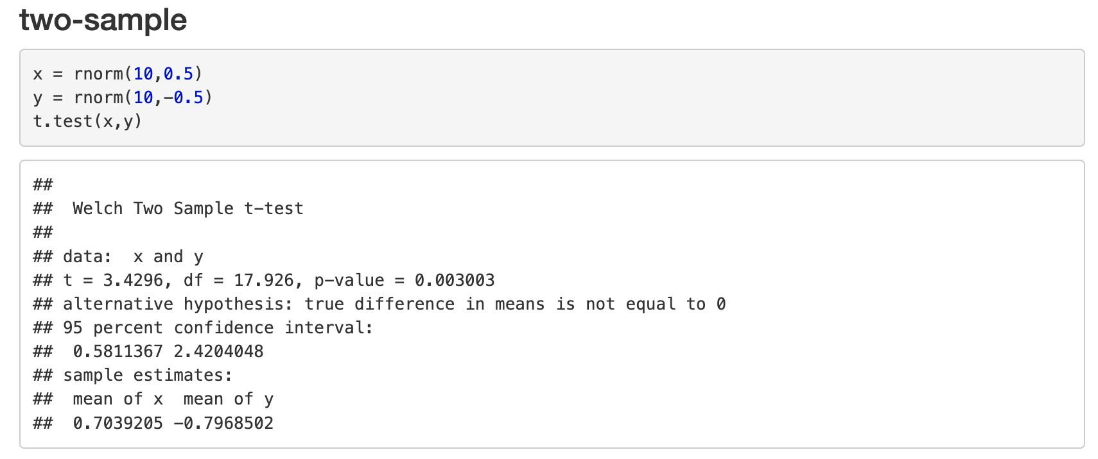
t-test is really just a linear model (make up some data)

Slide 34
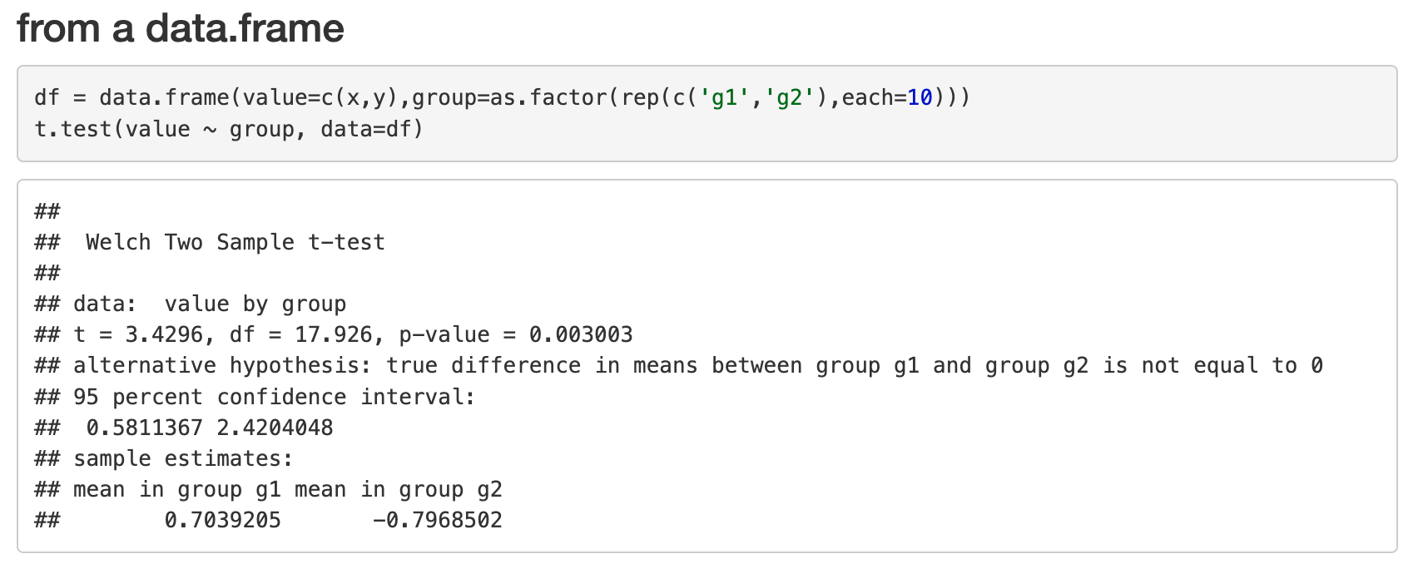
t-test is really just a linear model (our usual unequal variance t-test)

Slide 35
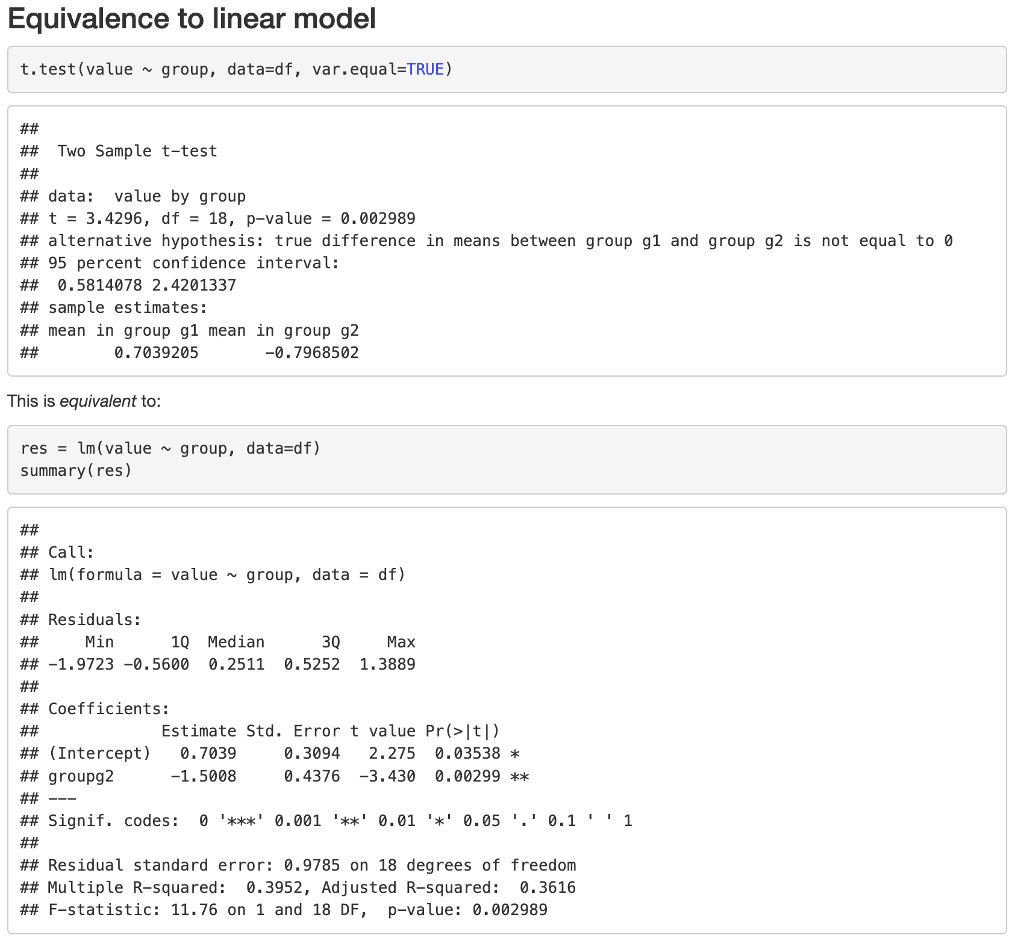
t-test is really just a linear model (t.test specification vs. lm specification)

